Slide 1


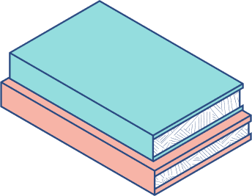

Basic of C Programming
Presented by:
Group:-8
Deepak Kumar Beniya
Debasish Sahoo
Satyam Barun Nayak
Under the Guidance of
MR GOPAL SIR

Slide 2
CONTENTS
02
/18
Topic Name
Page No.
Data Types
Operators
Control Statements
Loops
Functions
Array
Pointers
Structures
3
6
9
12
15

Slide 3
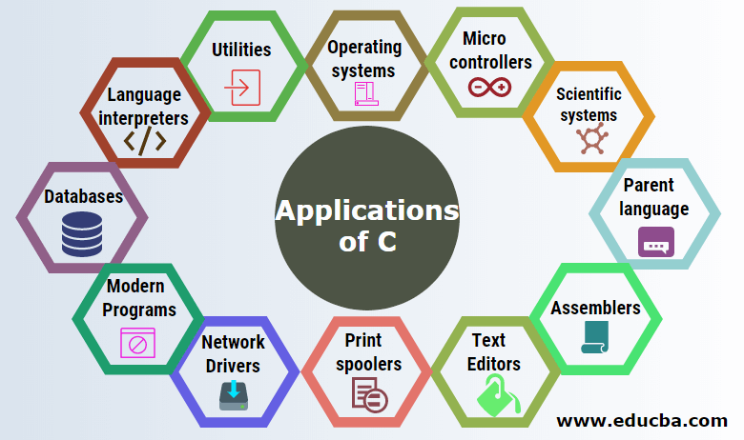
02
/18

Slide 4
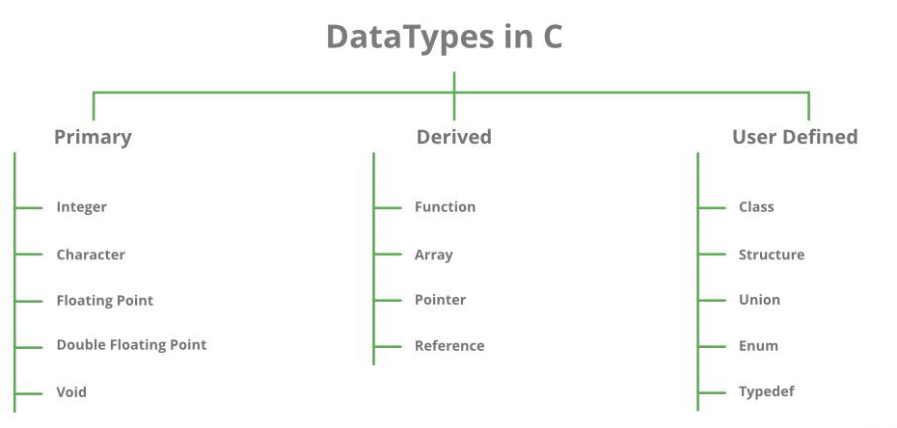
Data Types
03
/18

Slide 5
Data Types
04
/18
A data type is a classification of data which tells the compiler or interpreter how the programmer intends to use the data.
A data type specifies the type of data that a variable can store such as integer, Char, Float.
The data type defines which operations can safely be performed to create, transform and use the variable in another computation.
When a program language requires a variable to only be used in ways that respect its data type, that language is said to be strongly typed.
Although the size of any unsigned as well as the signed data type is all the same, they both possess different ranges of values to be stored in any variable.

Slide 6
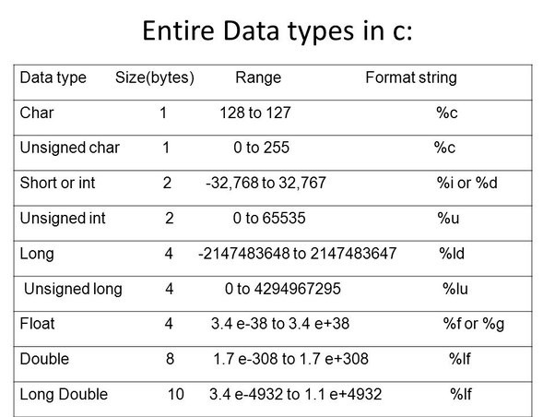
05
/18

Slide 7
Operators
06
/18
Operators are the foundation of any programming language. We can define operators as symbols that help us to perform specific mathematical and logical computations on operands.
In other words, we can say that an operator operates the operands.
Arithmetic Operators
Relational Operators
Logical Operators
Bitwise Operators
Assignment Operators
Other Operators

Slide 8
Operators
07
/18
1. Arithmetic Operators: These operators are used to perform arithmetic/mathematical operations on operands. Examples: (+, -, *, /, %,++,–).
2. Relational Operators: These are used for the comparison of the values of two operands. For example, checking if one operand is equal to the other operand or not, whether an operand is greater than the other operand or not, etc. Some of the relational operators are (==, >= , <= ).
3. Logical Operators: Logical Operators are used to combine two or more conditions/constraints or to complement the evaluation of the original condition in consideration. The result of the operation of a logical operator is a Boolean value either true or false.

Slide 9
Operators
08
/18
4. Bitwise Operators: The Bitwise operators are used to perform bit-level operations on the operands. The operators are first converted to bit-level and then the calculation is performed on the operands.
5. Assignment Operators: Assignment operators are used to assign value to a variable. The left side operand of the assignment operator is a variable and the right side operand of the assignment operator is a value.
6. Other Operators: Apart from the above operators, there are some other operators available in C used to perform some specific tasks.
such like size of operator, Conditional Operators

Slide 10
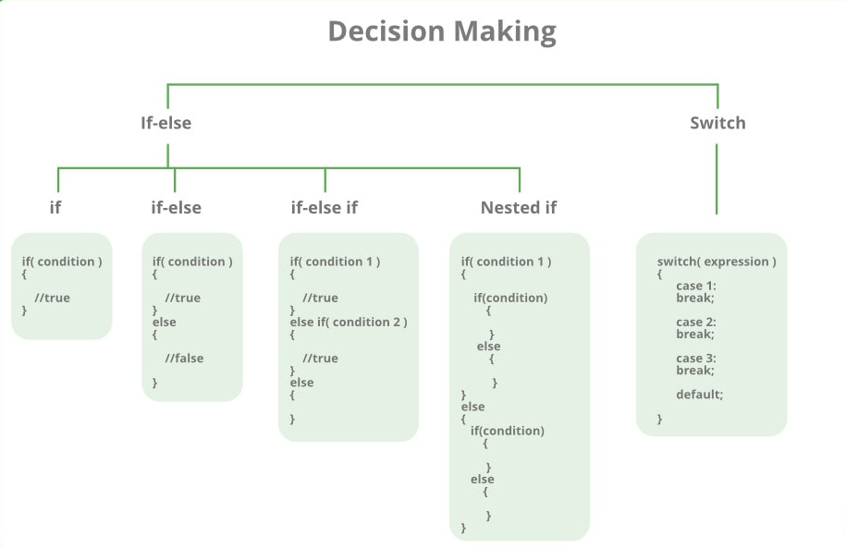
Control Statement
09
/18

Slide 11
Control Statement
10
/18
The Decision Making Statements are used to evaluate the one or more conditions and make the decision whether to execute set of statement or not.
1. if : if statement is the most simple decision-making statement. It is used to decide whether a certain statement or block of statements will be executed or not i.e if a certain condition is true then a block of statement is executed otherwise not.
2. if-else :The if statement alone tells us that if a condition is true it will execute a block of statements and if the condition is false it won’t. But what if we want to do something else if the condition is false.

Slide 12
Control Statement
11
/18
3. nested-if :A nested if in C is an if statement that is the target of another if statement. Nested if statements mean an if statement inside another if statement.
4. if-else-if ladder: Here, a user can decide among multiple options. The C if statements are executed from the top down. As soon as one of the conditions controlling the if is true, the statement associated with that if is executed, and the rest of the C else-if ladder is bypassed.
5.Switch case statement evaluates a given expression and based on the evaluated value(matching a certain condition), it executes the statements associated with it. Basically, it is used to perform different actions based on different conditions(cases).

Slide 13
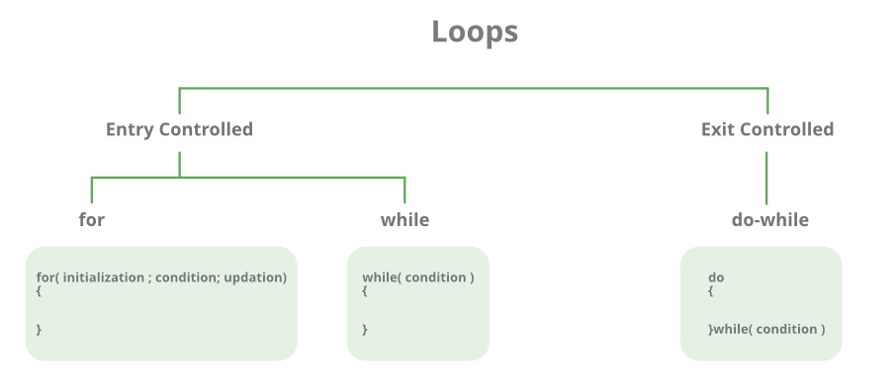
Loops
12
/18
Loops in programming are used to repeat a block of code until the specified condition is met. A loop statement allows programmers to execute a statement or group of statements multiple times without repetition of code.

Slide 14
Loops
13
/18
for Loop :for loop in C programming is a repetition control structure that allows programmers to write a loop that will be executed a specific number of times. for loop enables programmers to perform n number of steps together in a single line.
While Loop: While loop does not depend upon the number of iterations. In for loop the number of iterations was previously known to us but in the While loop, the execution is terminated on the basis of the test condition. If the test condition will become false then it will break from the while loop else body will be executed.

Slide 15
Loops
14
/18
3. do-while Loop: The do-while loop is similar to a while loop but the only difference lies in the do-while loop test condition which is tested at the end of the body. In the do-while loop, the loop body will execute at least once irrespective of the test condition.
initialization_expression;
do
{
// body of do-while loop
update_expression;
} while (test_expression);

Slide 16
Functions
15
/18
Functions are sets of statements that take inputs, perform some operations, and produce results. The operation of a function occurs only when it is called.
Rather than writing the same code for different inputs repeatedly, we can call the function instead of writing the same code over and over again.
Function declarations tell the compiler how many parameters a function takes, what kinds of parameters it returns, and what types of data it takes. Function declarations do not need to include parameter names, but definitions must.

Slide 17
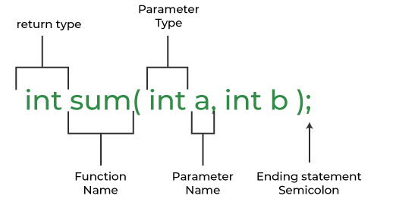
Functions
16
/18

Slide 18
Functions
17
/18
Function Declarations: Function declarations tell the compiler how many parameters a function takes, what kinds of parameters it returns, and what types of data it takes. Function declarations do not need to include parameter names, but definitions must.
The parameters passed to function are called actual parameters whereas the parameters received by function are called formal parameters.
Call By Value: In this parameter passing method, values of actual parameters are copied to function’s formal parameters and the two types of parameters are stored in different memory locations. So any changes made inside functions are not reflected in actual parameters of the caller.

Slide 19
Functions
17
/18
Type of declarations
1.No return type functions(no arguments)
2. with return type functions(with arguments)
3. with return type functions(no arguments)
4.no return type functions(with arguments)

Slide 20
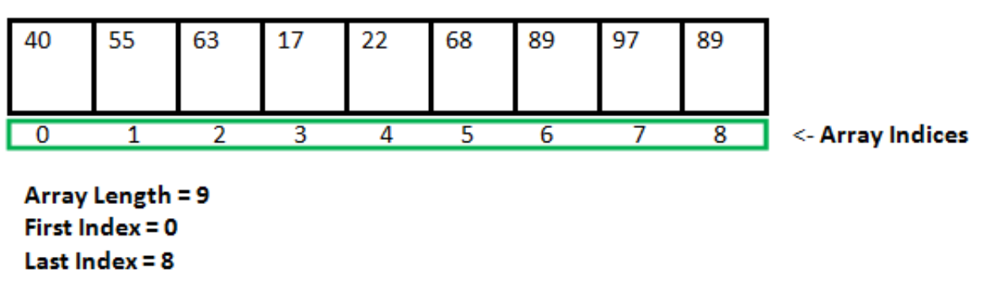
Array
An array in C/C++ or be it in any programming language is a collection of similar data items stored at contiguous memory locations and elements can be accessed randomly using indices of an array.
They can be used to store the collection of primitive data types such as int, float, double, char many more of any particular type. To add to it, an array in C/C++ can store derived data types such as structures, pointers etc. Given below is the picture representation of an array.

Slide 21
Array
Why do we need arrays?
We can use normal variables (v1, v2, v3, ..) when we have a small number of objects, but if we want to store a large number of instances, it becomes difficult to manage them with normal variables. The idea of an array is to represent many instances in one variable.
Advantages:-
Code Optimization: we can retrieve or sort the data efficiently.
Random access: We can get any data located at an index position.
Disadvantages:-
Size Limit: We can store only the fixed size of elements in the array. It doesn’t grow its size at runtime.

Slide 22
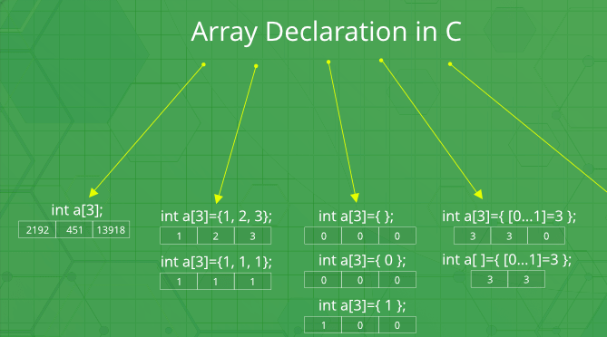
Array

Slide 23
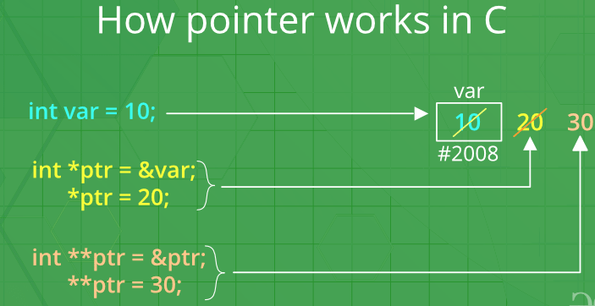
Pointers
Pointers in C are used to store the address of variables or a memory location.
This variable can be of any data type i.e, int, char, function, array, or any other pointer.
The pointer of type void is called Void pointer or Generic pointer.

Slide 24
Pointers
Uses of pointer
To pass arguments by reference
For accessing array elements
To return multiple values
Dynamic memory allocation
To Implement data structures
To do System-Level Programming where memory addresses are useful
To help locating exact value at exact location.
To avoid compiler confusion for same variable name.
To use in Control Tables.

Slide 25
Pointers
Void Pointers:-
A Void Pointer in C can be defined as an address of any variable. It has no standard data type. A void pointer is created by using the keyword void.
NULL Pointers:-
Null pointers can be created by assigning a zero value during pointer declaration. This method is useful when no address is assigned to the pointer.
Pointers can be assigned in 3 ways:-
Address
Null
Zero(0)

Slide 26
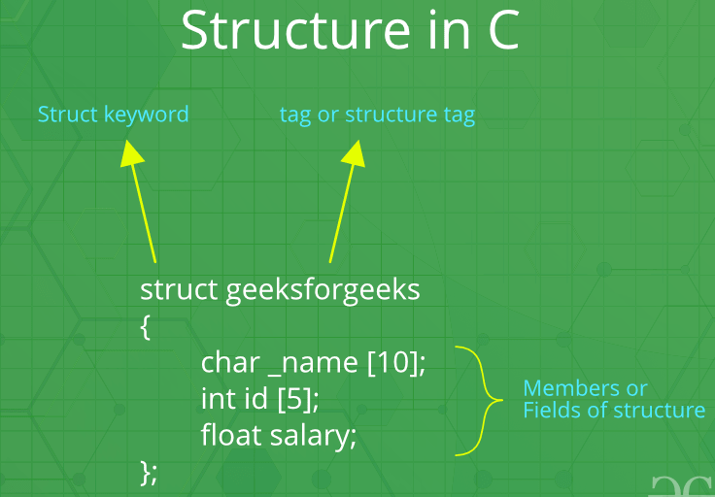
Structures
A structure is a keyword that creates user-defined data types in C.
A structure creates a data type that can be used to group items of possibly different types into a single type.

Slide 27
Structures
Where to use the Structure data type?
We can use this data type to store dates of different attributes of different data types.
For example, If we want to store data on multiple patients such as patient name, age, and blood group.
Why structs in C?
Suppose you want to store information about a person: his/her name, citizenship number, and salary. You can create different variables name, mobNo, and salary to store this information.

Slide 28
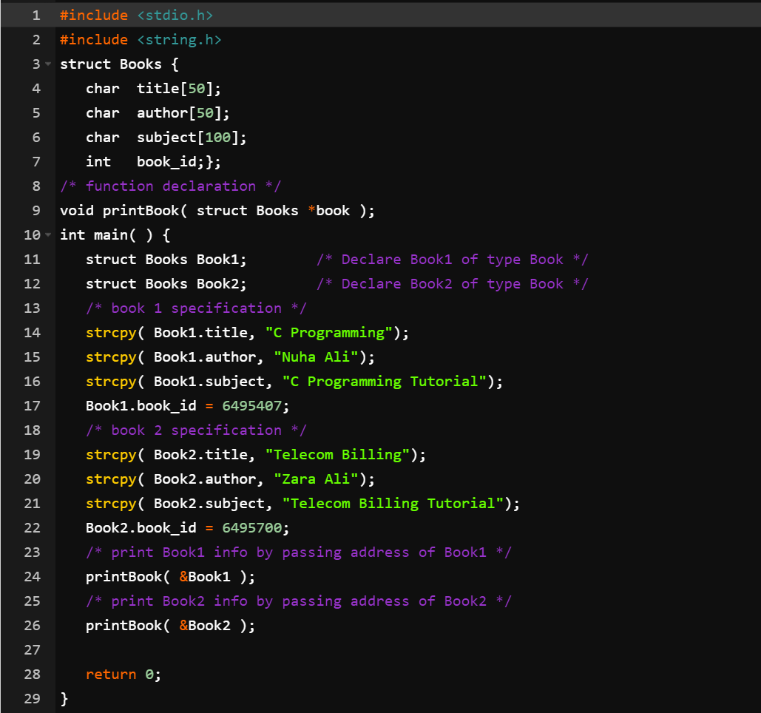
Structures

Slide 29


